Slide 1

Web Scraping Project
Stock Market
By: Miral Dhrafani
Ivan Gonzalez
Yameiry Diaz

Slide 2
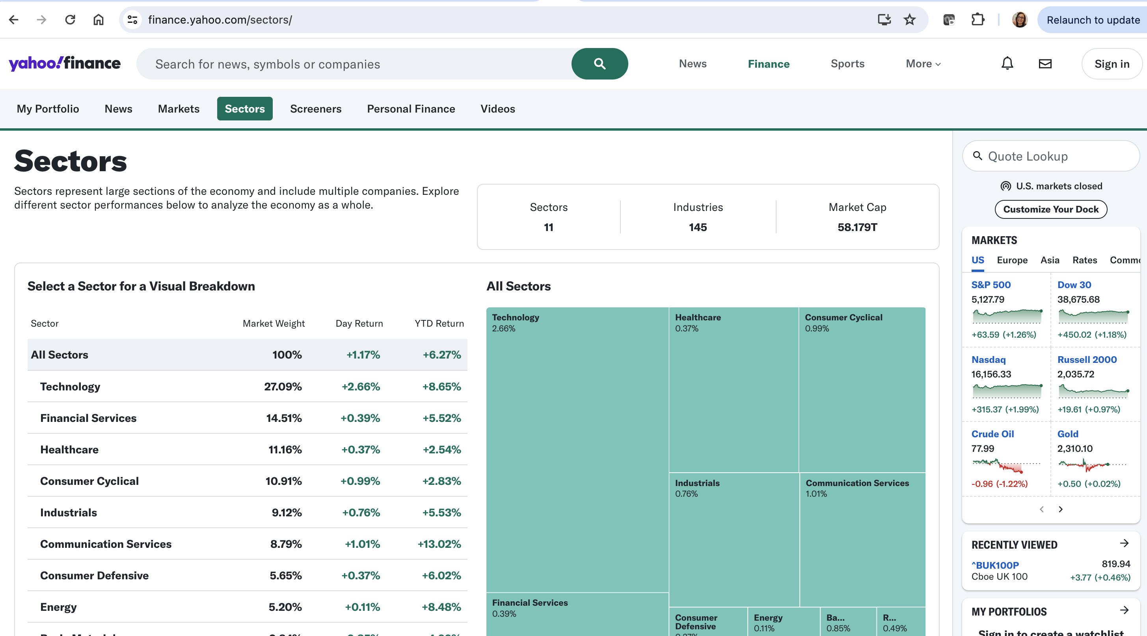
Introduction
Exploring Stock Market by sector using Yahoo Finance webpage

Slide 3

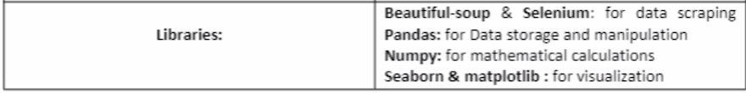
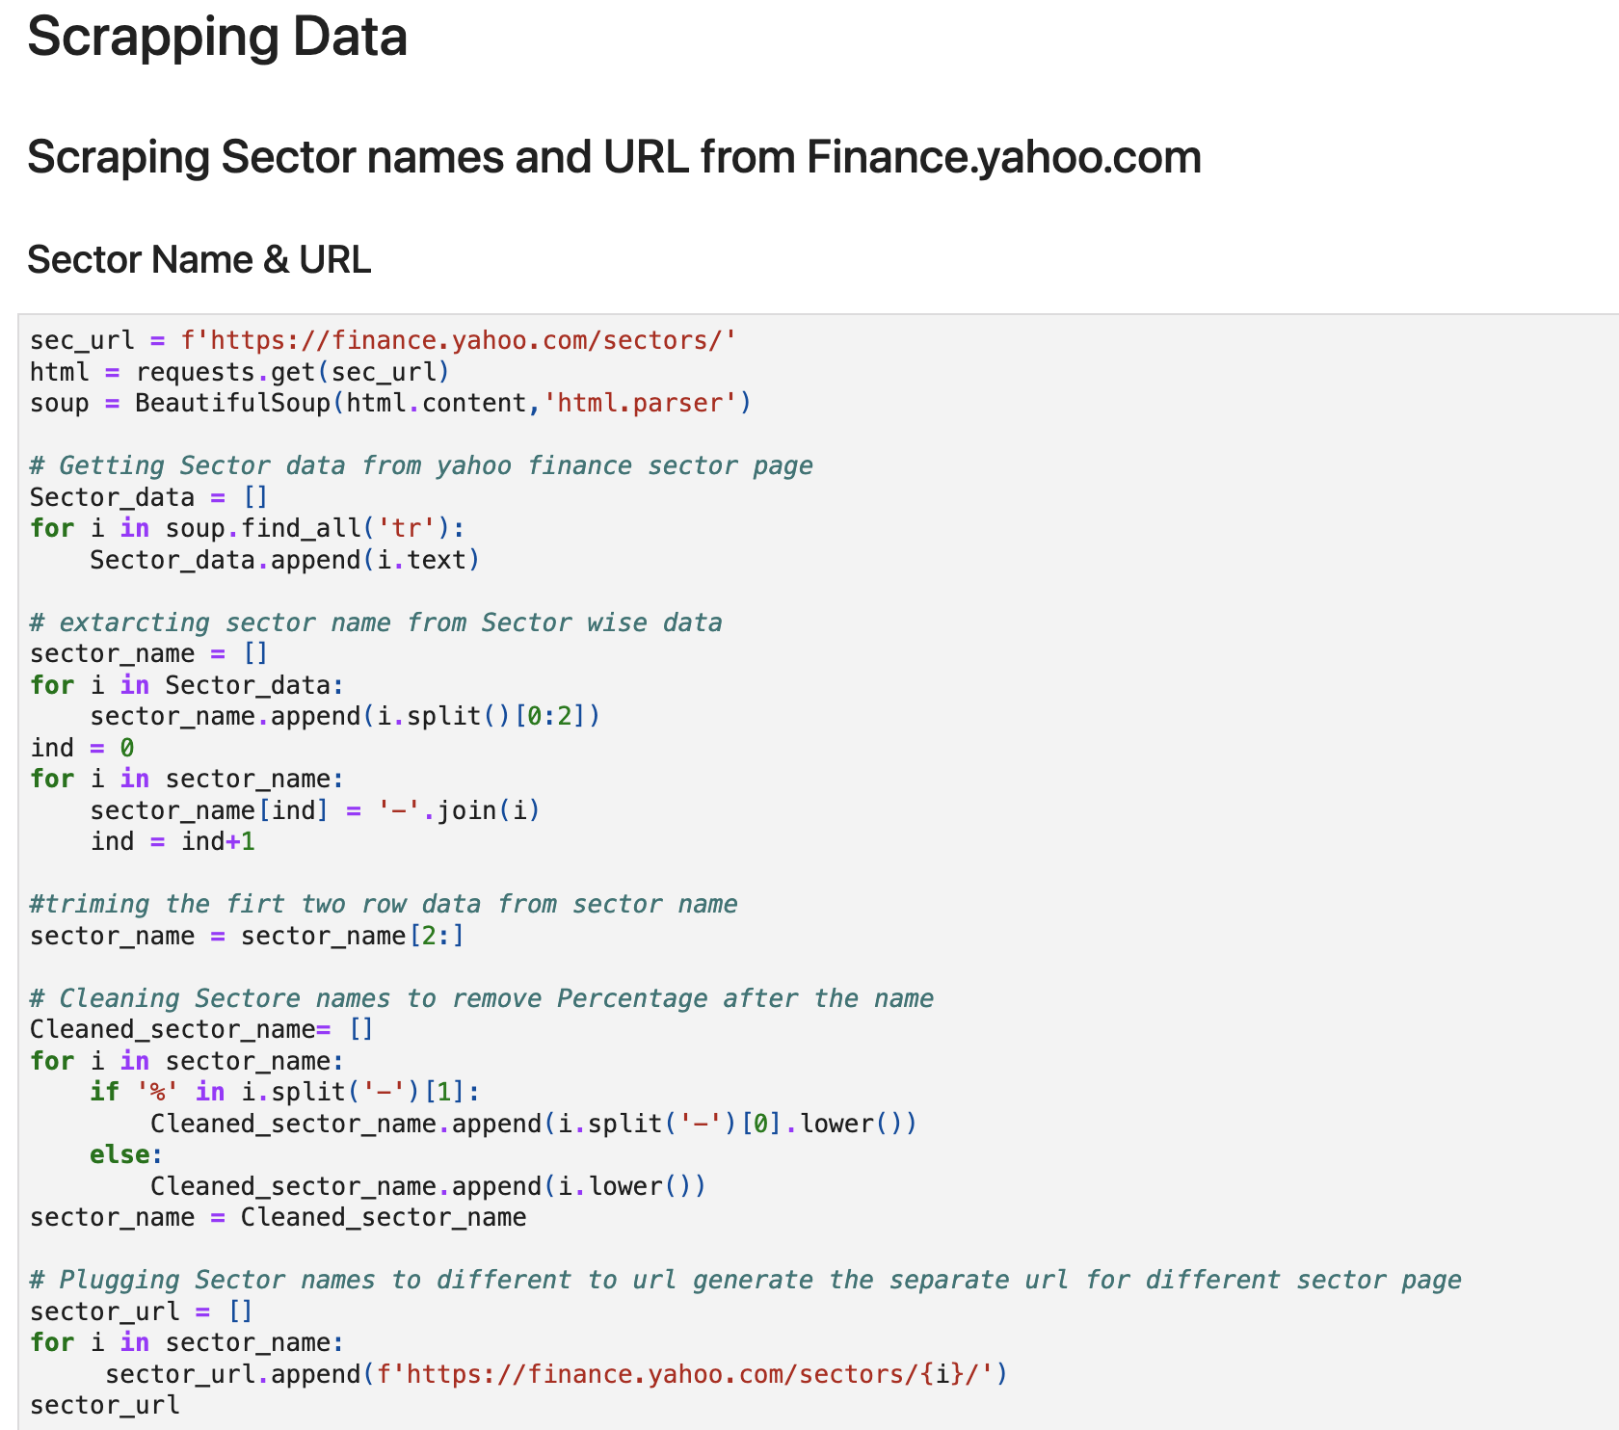
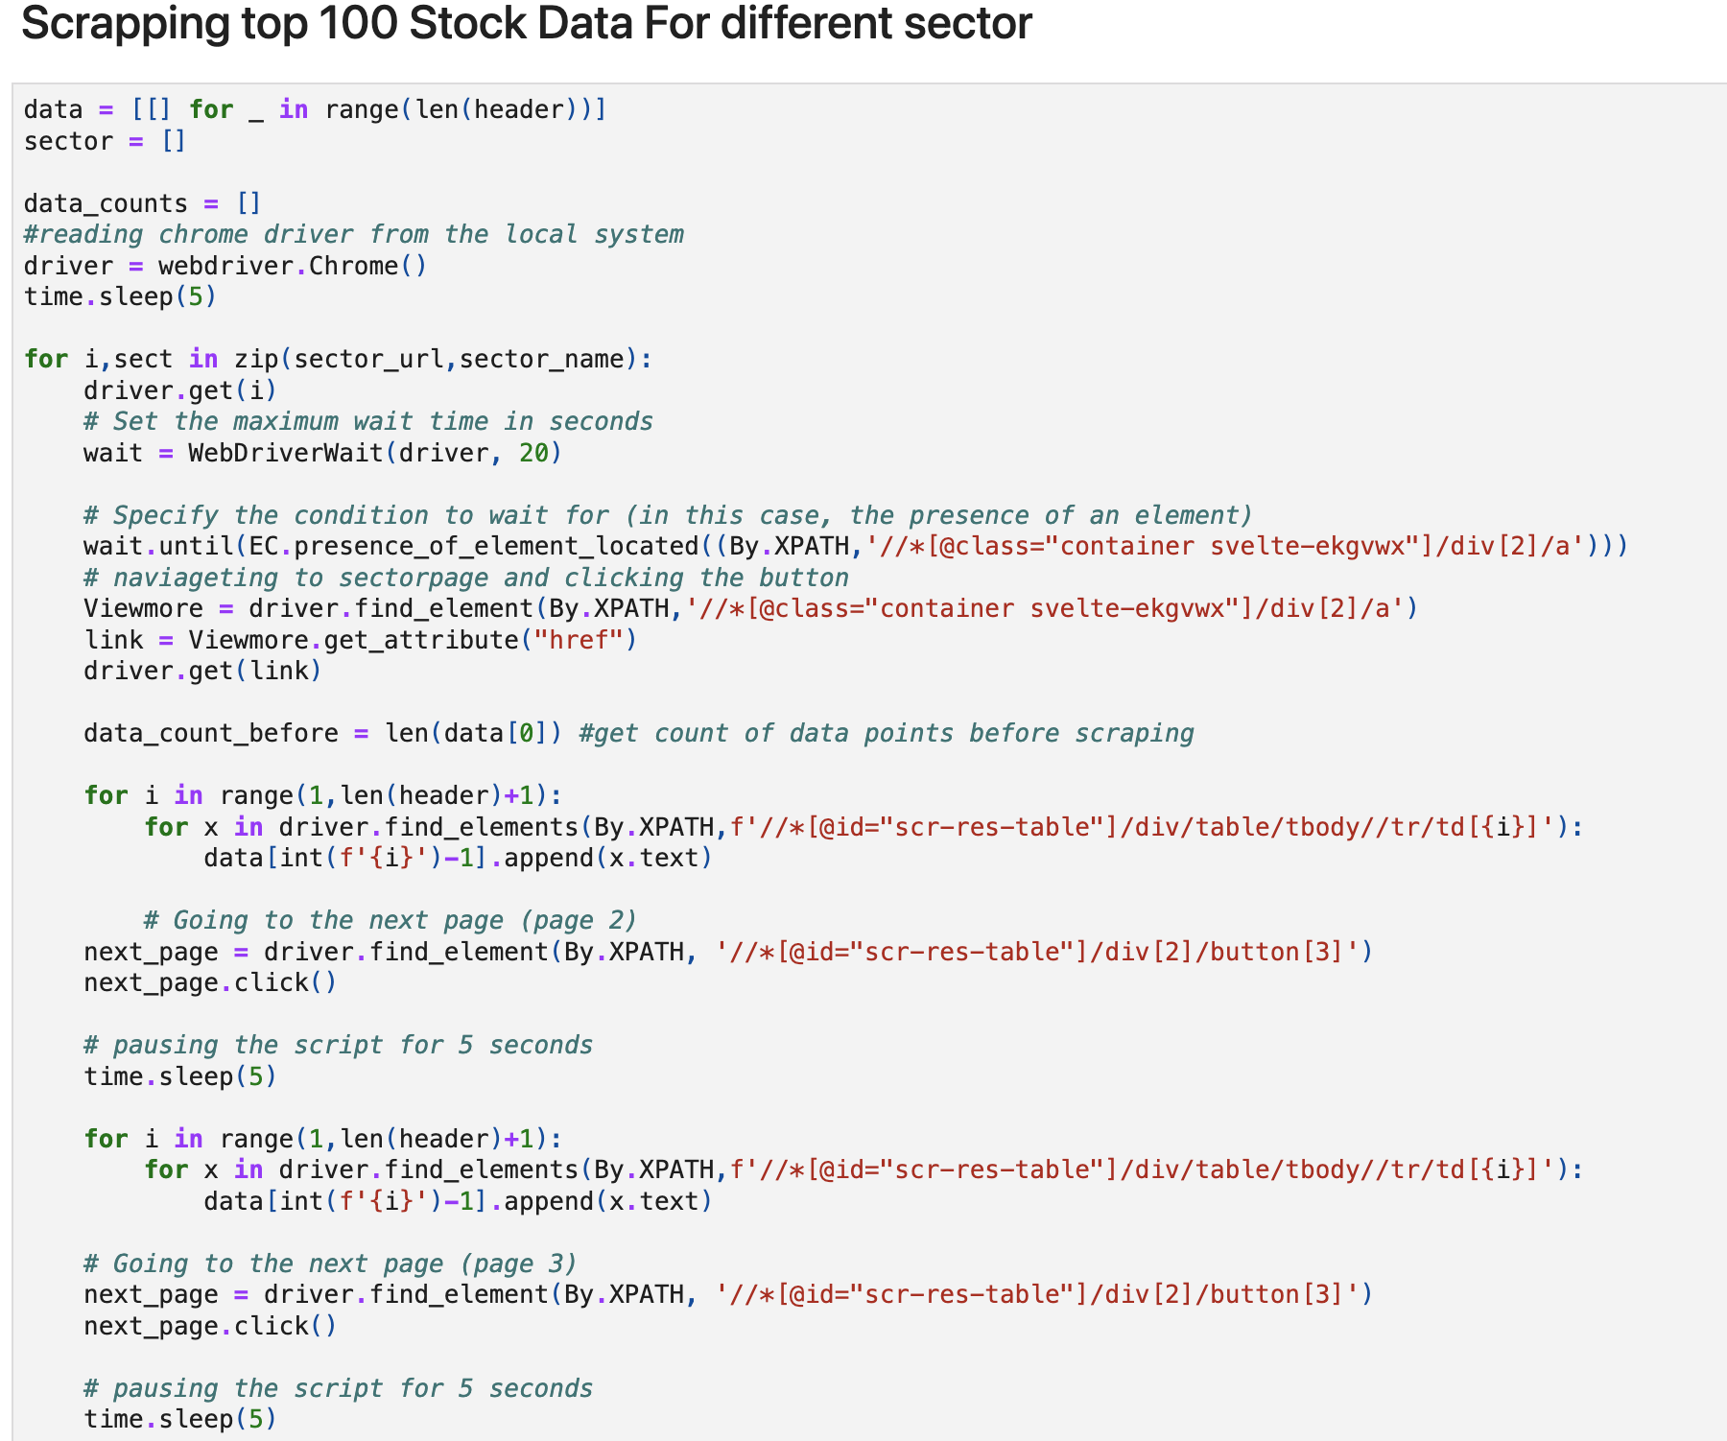
Data Gathering
Web Scraping

Slide 4
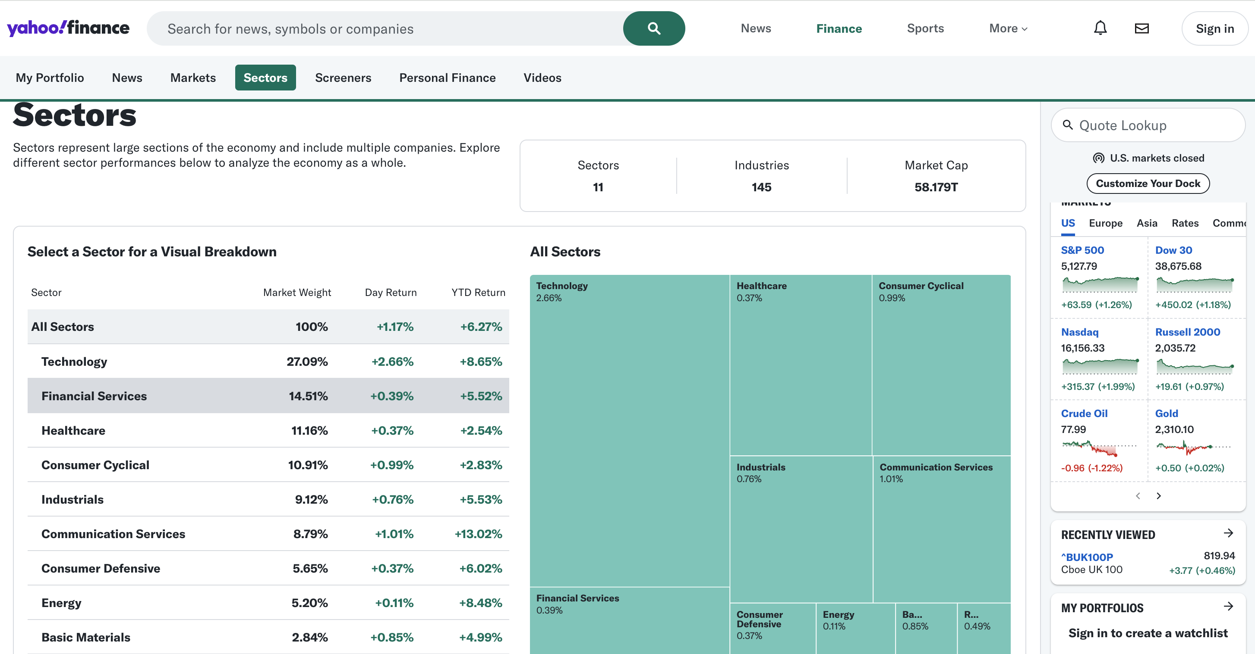
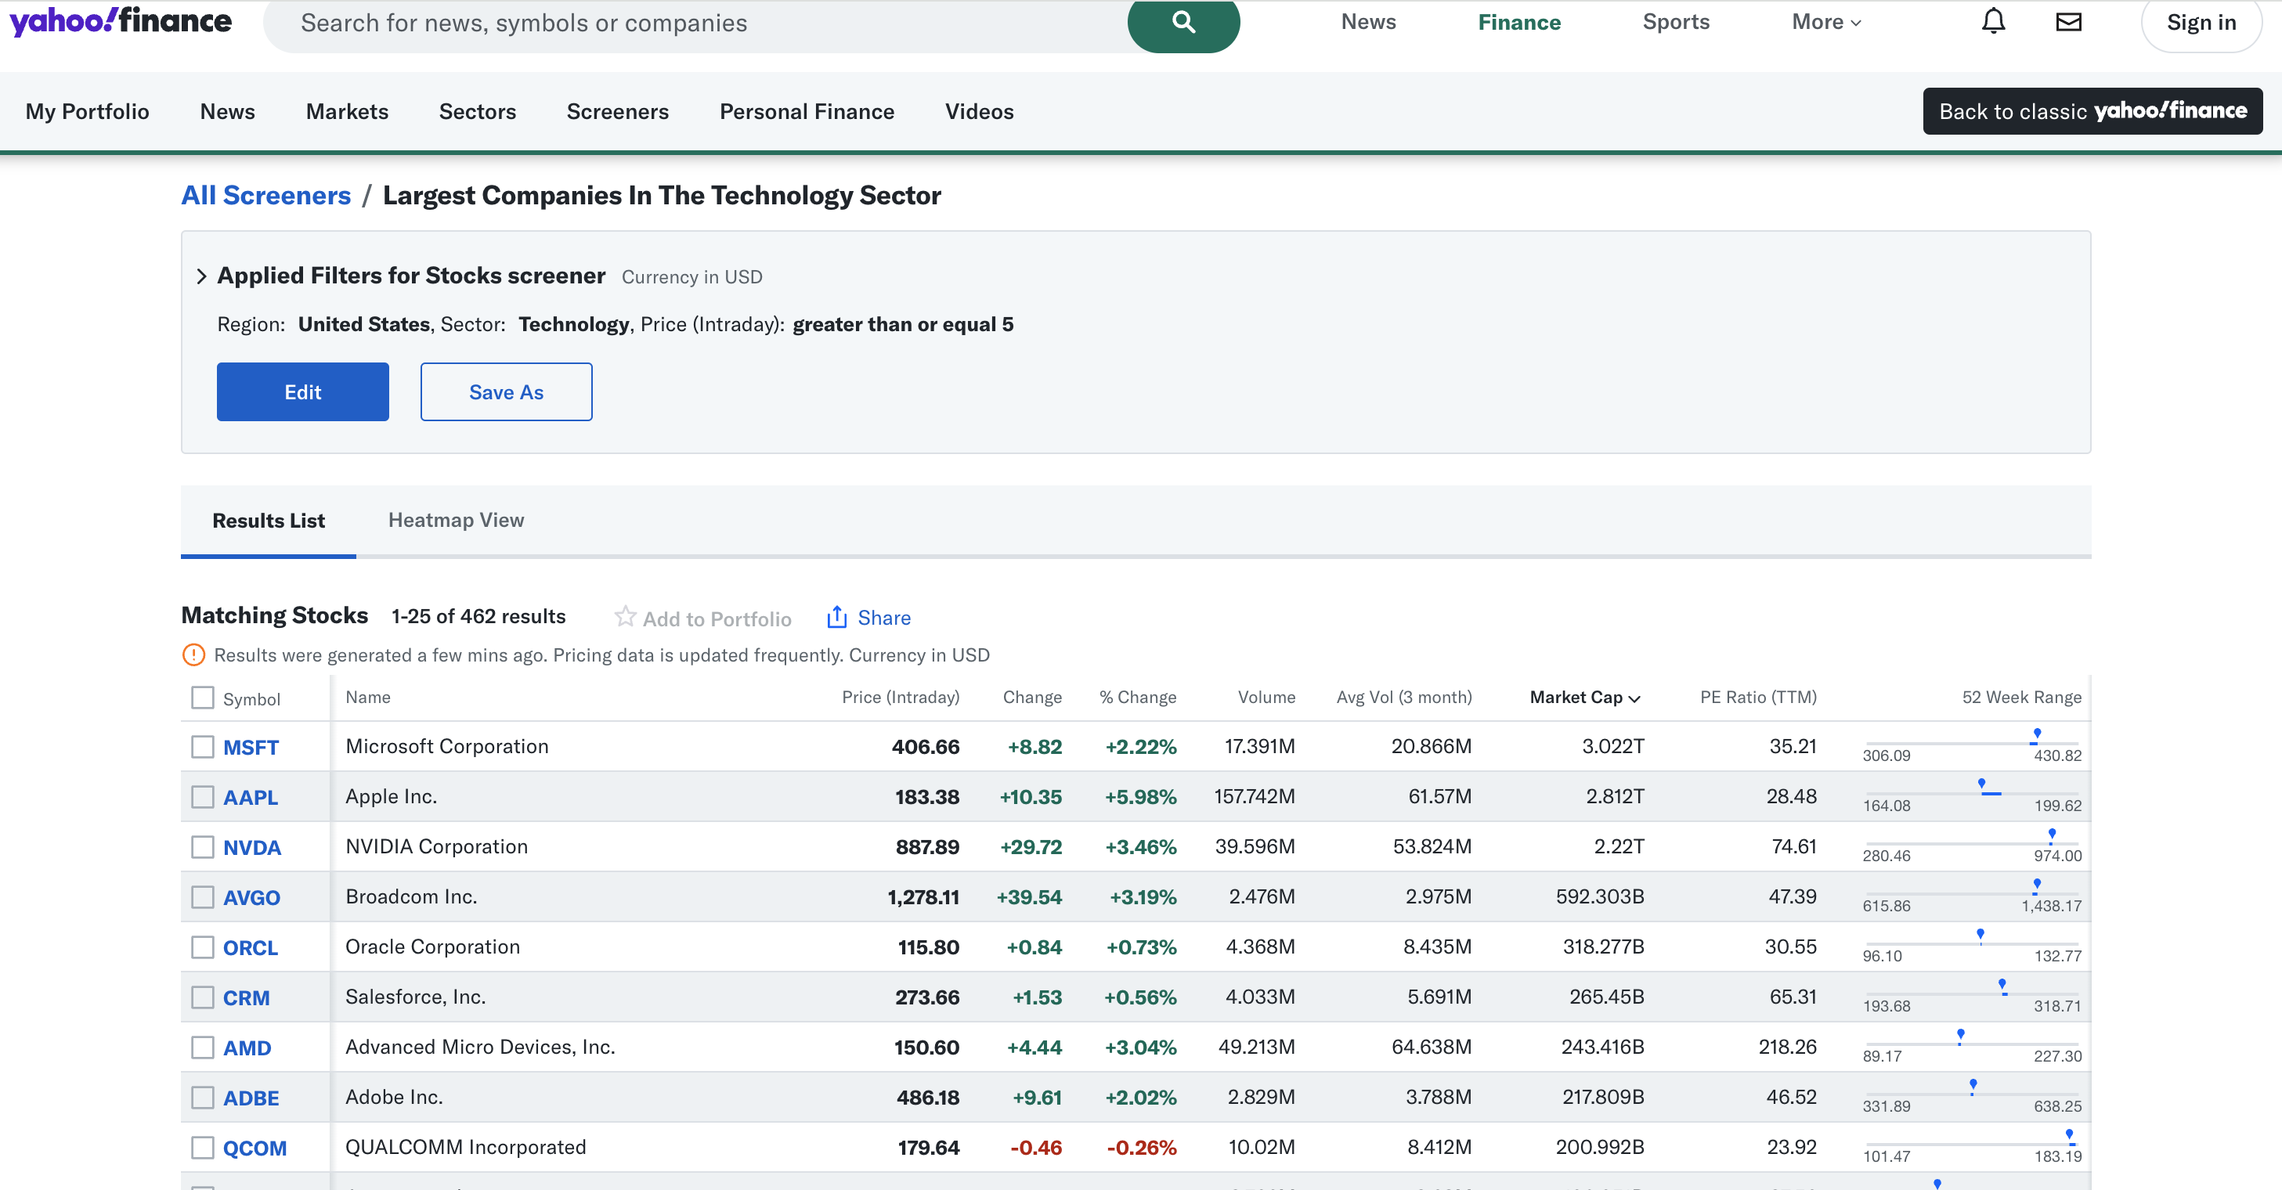
Analyses from 11 Sectors
Scrapping top 100 Stocks Data for each sector

Slide 5
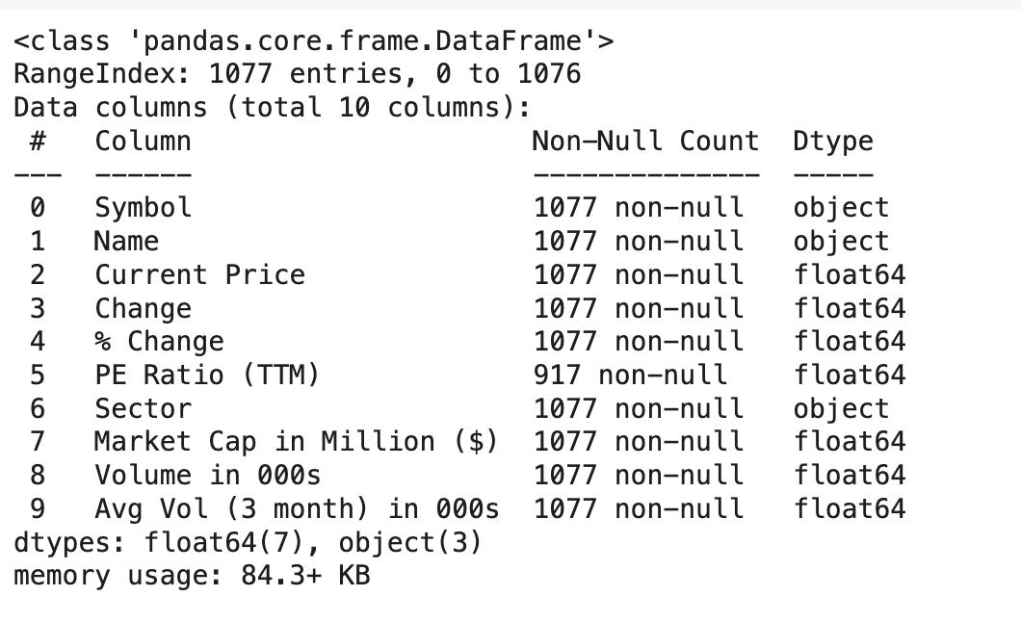
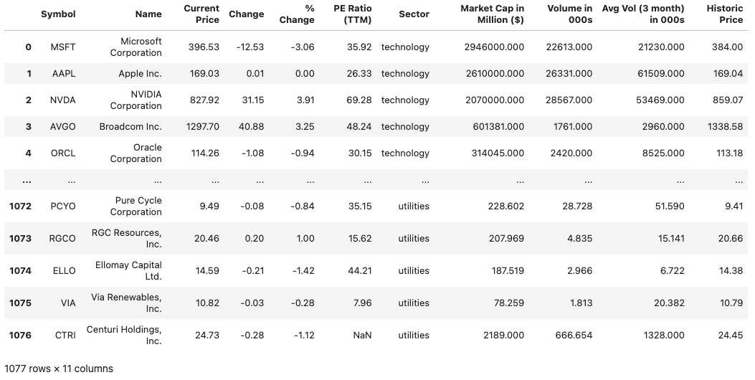
Converted from data type object to float for the analyses.
Data Set

Slide 6

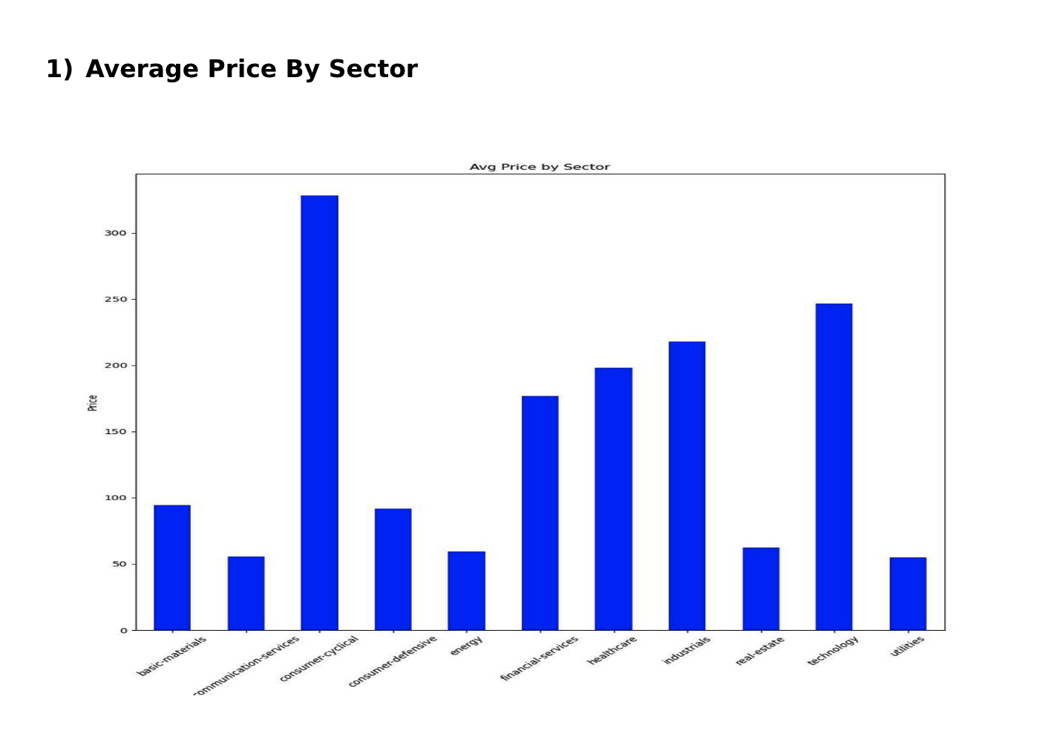
Visualization
1. Average price by Sector

Slide 7
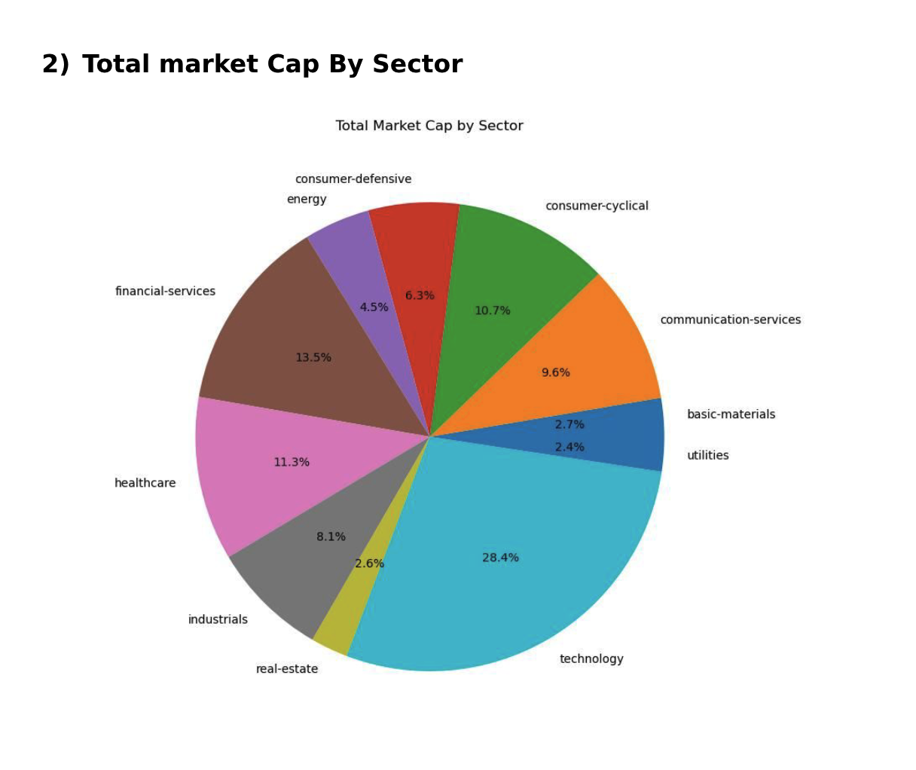
2. Total Market Cap by Sector

Slide 8
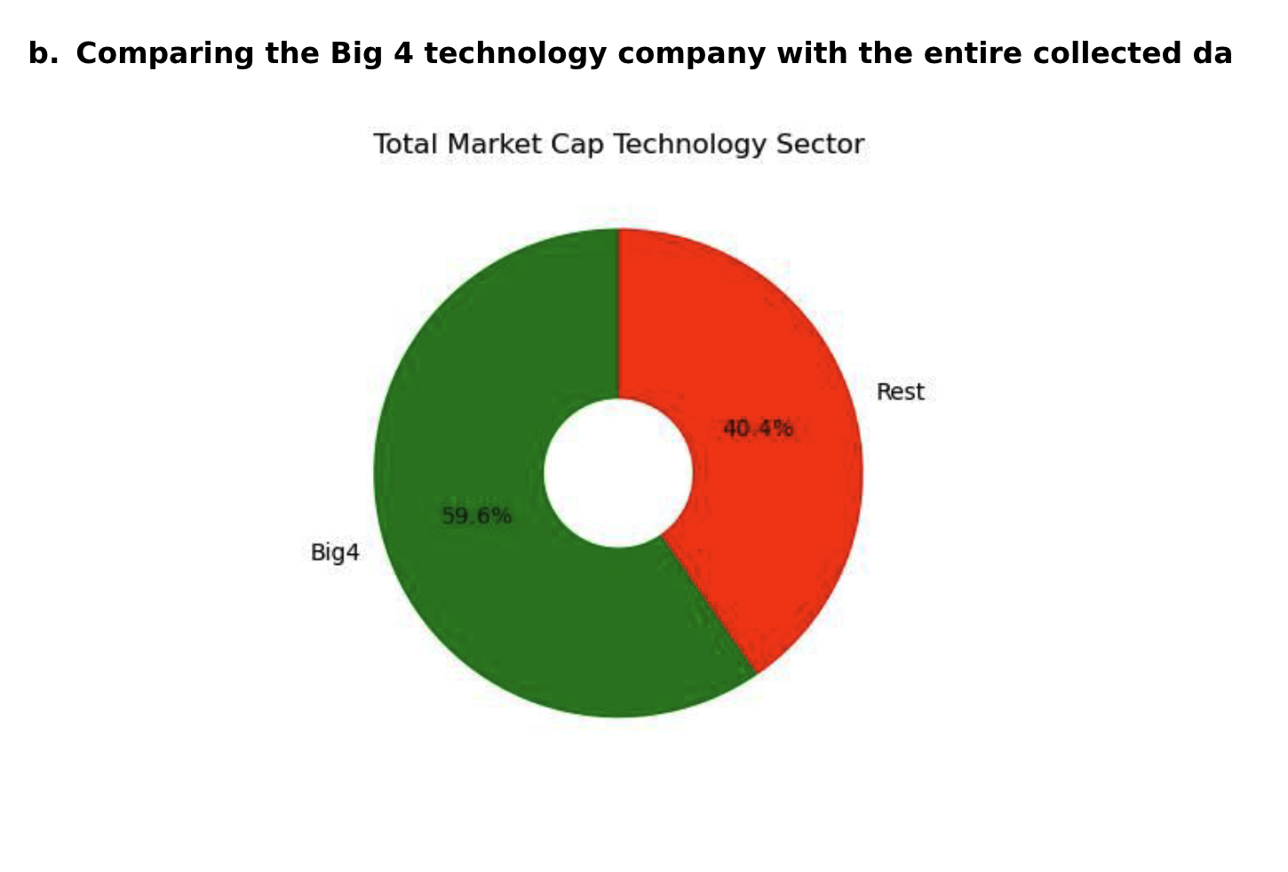
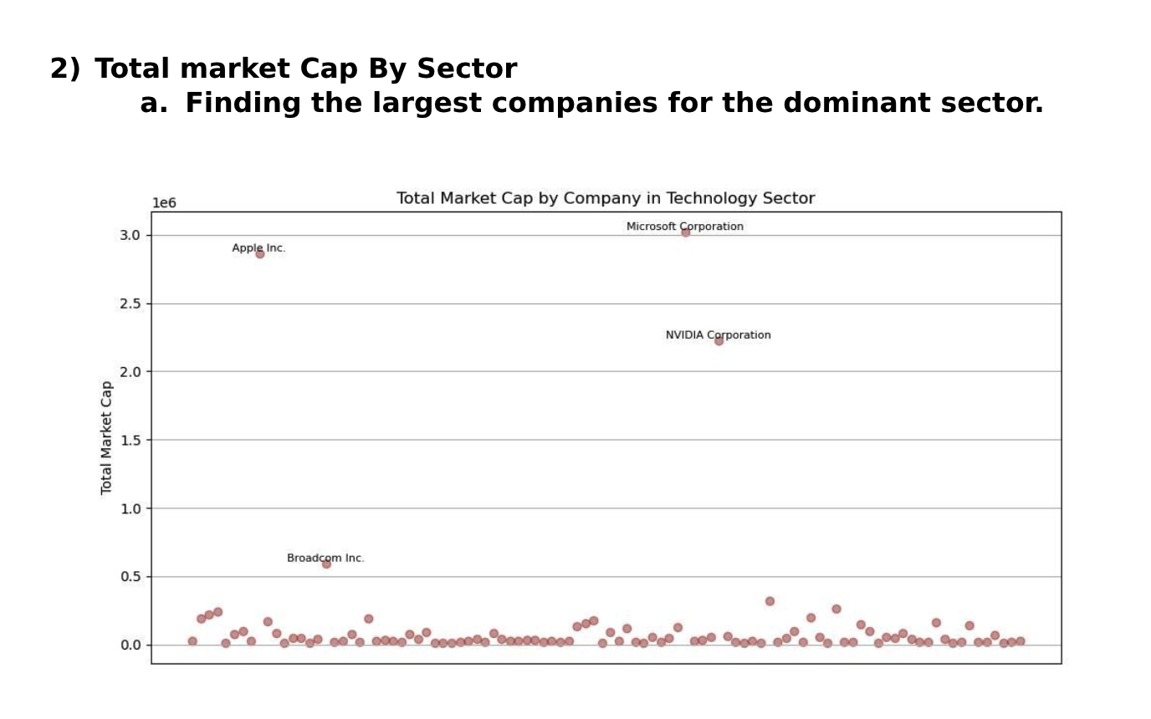
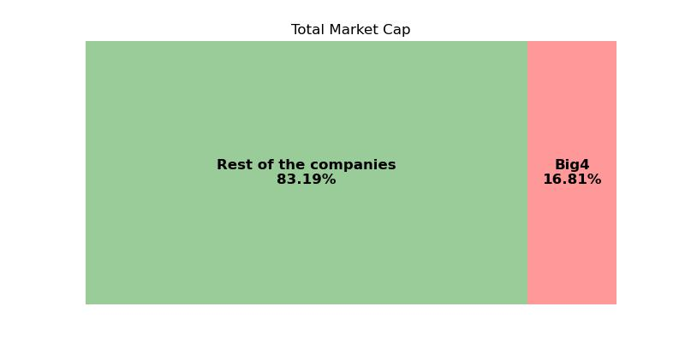
2a. Total Market Cap by Company in Technology Sector

Slide 9
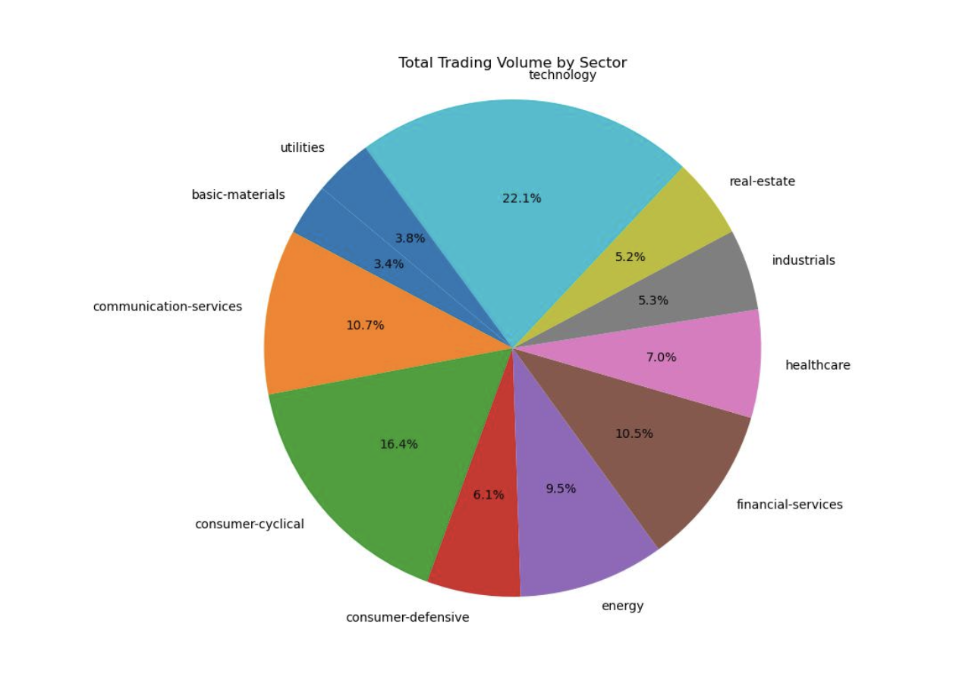
3. Total trading Volume by sector

Slide 10
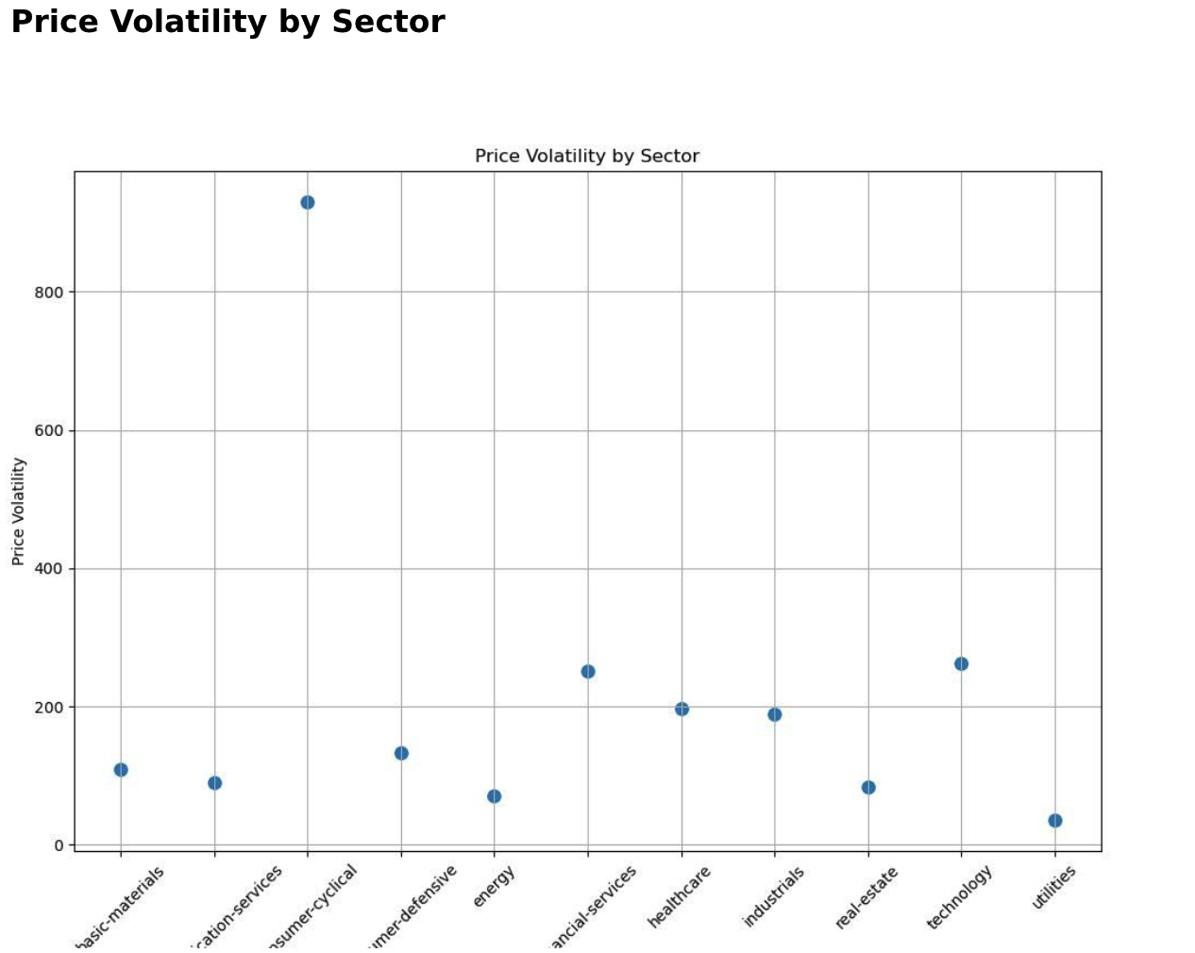
4. Price Volatility by Sector:

Slide 11
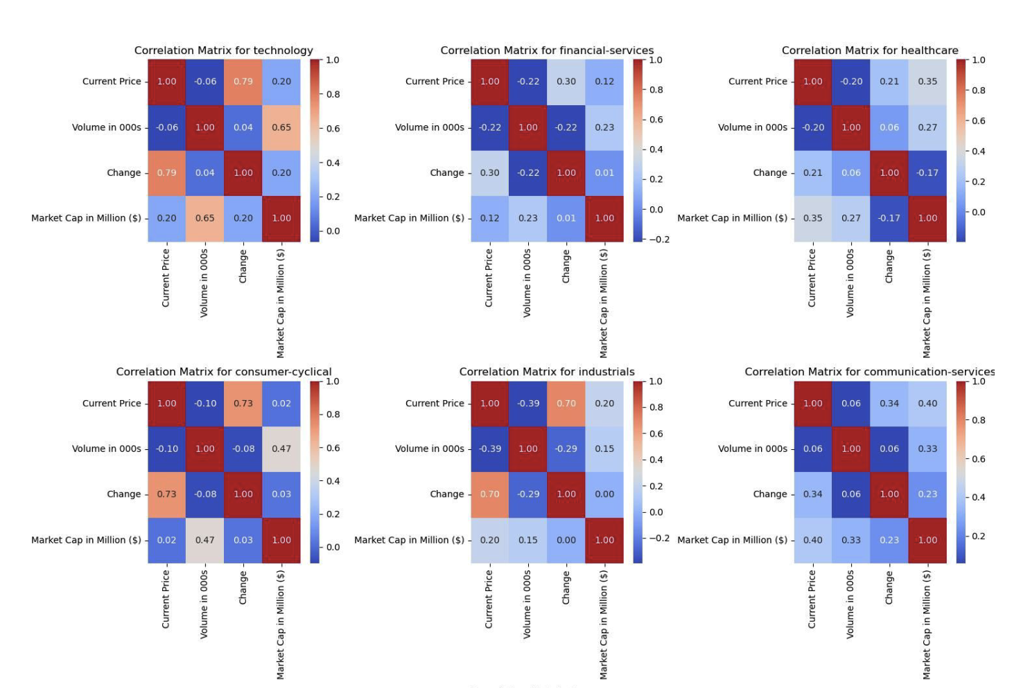
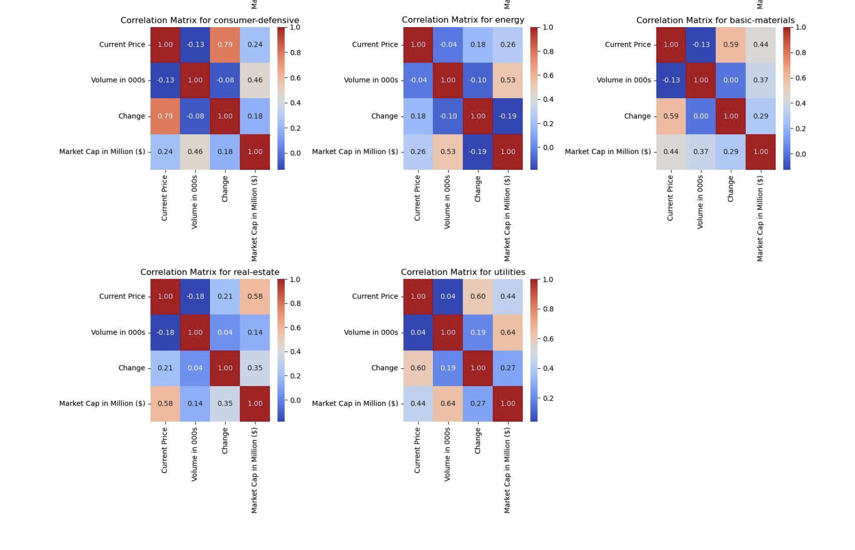
5. Correlation Analysis

Slide 12
Challenges
1. Data Timeliness: Our analysis is based on present values, limiting the ability to identify long-term trends or historical patterns.
2. Market Volatility: The stock market is inherently volatile, and our analysis may not capture sudden market movements or fluctuations that occur after data collection.
3. Data Completeness: While we strive to collect comprehensive data, there may be
limitations in the availability or accuracy of the information obtained through web scraping.
4. External Factors: Market performance can be influenced by various external factors such as economic conditions, geopolitical events, and regulatory changes, which are not fully captured in our analysis.

Slide 13

Conclusion
Our Analysis of stock market data scraped from Yahoo Finance offers Valuable insights into the current state of various sectors. By employing web scraping techniques and visualizing the data, we’ve gained a clear understanding of sector-wise performance, market capitalization, trading volume, and price volatility as of the present moment.
It’s important to note that our data reflects current values and trends, providing a snapshot of the market dynamics at a specific point in time. While these insights offer valuable guidance for decision-making, they are subject to change a market conditions evolve.
Our analysis revealed the dominance of certain sectors, with technology emerging as a frontrunner in market capitalization and trading activity. Additionally, we identified major players within these sectors, shedding light on their market influence and significance.

Slide 14

Thank you!

